Slide 1

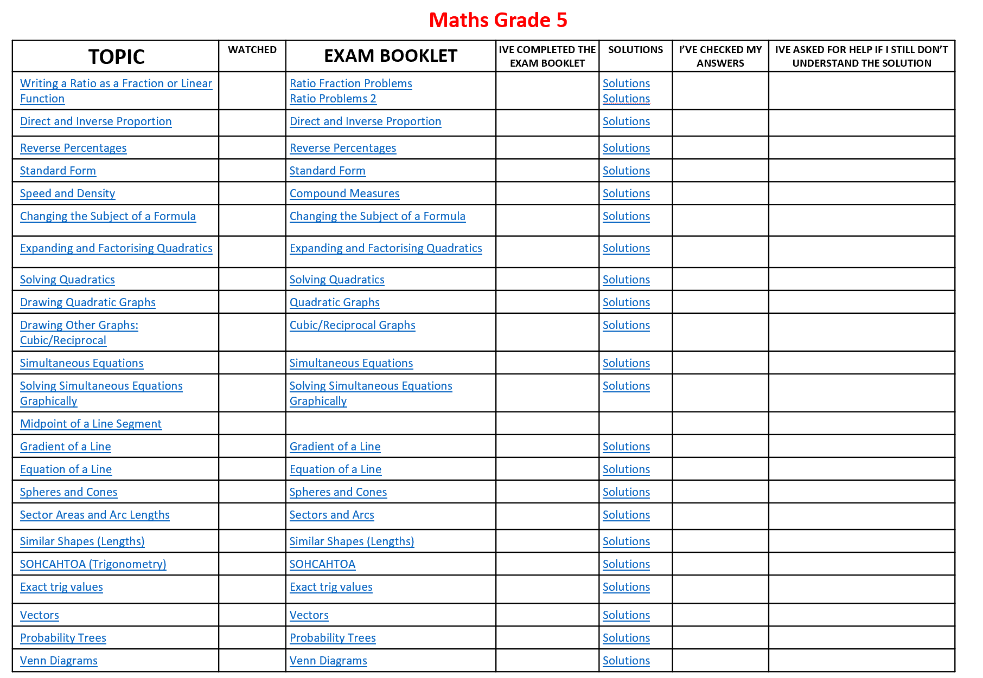
Supporting your child this summer
GCSE Maths – links to Maths Genie
Topic how to videos, Exam Booklets and Solutions

Slide 2
Maths GCSE Grade 5
TOPIC | WATCHED | EXAM BOOKLET | IVE COMPLETED THE EXAM BOOKLET | SOLUTIONS | I’VE CHECKED MY ANSWERS | IVE ASKED FOR HELP IF I STILL DON’T UNDERSTAND THE SOLUTION
Writing a Ratio as a Fraction or Linear Function |  | Ratio Fraction Problems Ratio Problems 2 |  | Solutions Solutions
Direct and Inverse Proportion |  | Direct and Inverse Proportion |  | Solutions
Reverse Percentages |  | Reverse Percentages |  | Solutions
Standard Form |  | Standard Form |  | Solutions
Speed and Density |  | Compound Measures |  | Solutions
Changing the Subject of a Formula |  | Changing the Subject of a Formula |  | Solutions
Expanding and Factorising Quadratics |  | Expanding and Factorising Quadratics |  | Solutions
Solving Quadratics |  | Solving Quadratics |  | Solutions
Drawing Quadratic Graphs |  | Quadratic Graphs |  | Solutions
Drawing Other Graphs: Cubic/Reciprocal |  | Cubic/Reciprocal Graphs |  | Solutions
Simultaneous Equations |  | Simultaneous Equations |  | Solutions
Solving Simultaneous Equations Graphically |  | Solving Simultaneous Equations Graphically |  | Solutions
Midpoint of a Line Segment
Gradient of a Line |  | Gradient of a Line |  | Solutions
Equation of a Line |  | Equation of a Line |  | Solutions
Spheres and Cones |  | Spheres and Cones |  | Solutions
Sector Areas and Arc Lengths |  | Sectors and Arcs |  | Solutions
Similar Shapes (Lengths) |  | Similar Shapes (Lengths) |  | Solutions
SOHCAHTOA (Trigonometry) |  | SOHCAHTOA |  | Solutions
Exact trig values |  | Exact trig values |  | Solutions
Vectors |  | Vectors |  | Solutions
Probability Trees |  | Probability Trees |  | Solutions
Venn Diagrams |  | Venn Diagrams |  | Solutions

